Slide 1
Industry Problem-2 RFC reading :
RFC 786 – USER DATAGRAM PROTOCOL
NAME : LIKHITH R SRN : PES1UG20CS659 SECTION : K DATE : 29-04-2022

Slide 2
Introduction :
This User Datagram Protocol (UDP) is defined to make available a datagram mode of packet-switched computer communication in the environment of an interconnected set of computer networks. This protocol assumes that the Internet Protocol (IP) is used as the underlying protocol. This protocol provides a procedure for application programs to send messages to other programs with a minimum of protocol mechanism. The protocol is transaction oriented, and delivery and duplicate protection are not guaranteed. Applications requiring ordered reliable delivery of streams of data should use the Transmission Control Protocol (TCP).

Slide 3
PURPOSE :
RFC 786 describes the basic UDP datagram: a source and destination port, length, and checksum. When IP delivers a UDP datagram, the host checks the port number and delivers the data to the corresponding application. This protocol provides a procedure for application programs to send messages to other programs with a minimum of protocol mechanism. The protocol is transaction oriented, and delivery and duplicate protection are not guaranteed. User Datagram Protocol (UDP) is a communications protocol that is primarily used to establish low-latency and loss-tolerating connections between applications on the internet. UDP speeds up transmissions by enabling the transfer of data before an agreement is provided by the receiving party.

Slide 4
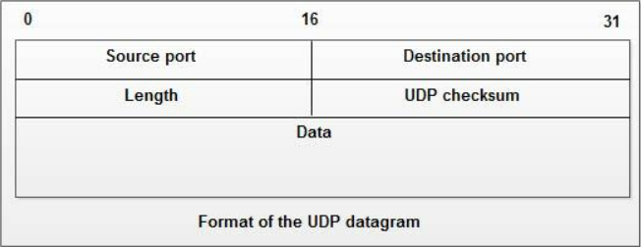
Message format :
Following is a brief description of each field: Source Port This is the port number of the application that is originating the user data. Destination Port This is the port number pertaining to the destination application. Length This field describes the total length of the UDP datagram, including both data and header Information. UDP Checksum Integrity checking is optional under UDP. If turned on, both ends of the communications channel use this field for data integrity checks.

Slide 5
Udp usage :
UDP: User Datagram Protocol [RFC 768] This protocol provides a procedure for application programs to send messages to other programs with a minimum of protocol mechanism. The protocol is transaction oriented, and delivery and duplicate protection are not guaranteed. The IP would verify certain fields for consistency and compute the internet header checksum. The major uses of this protocol is the Internet Name Server [3], and the Trivial File Transfer [4]. This is protocol 17 (21 octal) when used in the Internet Protocol. → UDP use: "best effort" service, "no frills," "bare bones“

Slide 6
UDP PROTOCOL RFC 768 USES :
UDP is A simple message-oriented transport layer protocol that is documented in RFC 768. Although UDP provides integrity verification (via checksum) of the header and payload, it provides no guarantees to the upper layer protocol for message delivery and the UDP layer retains no state of UDP messages once sent. Connectionless UDP: ▪ no handshaking between UDP sender, receiver ▪ add reliability at application layer application-specific error recovery! ▪each UDP segment handled independently of others

Slide 7
CONCLUSION
Conclusion is, For sure, the development of UDP (User Datagram Protocol) is revolutionary. It allows fast delivery, which is highly valuable for a number of applications. UDP finds its purpose in many services despite the fact it has some downsides, mainly in DNS, video streaming, and gaming.

